Slide 1
Fall 2017
Proposed Route
Modifications

Slide 2
Overarching Principles
Recognize our limitations
94 full-size buses to run day routes, night routes, charters, training and general / long-term maintenance
Serve densest student populations
Adapt to student growth and apartment location change
Efficient, timely, dependable service

Slide 3
Operation Focus for 2017
Serve more students and utilize student service fees wisely by:
Providing cost-effective service on- and off-campus
Adapting and reallocating buses to serve areas most heavily populated by students
Keeping costs down by not increasing the number of service hours by:
Reallocating buses from off campus to on campus to better serve needs mid-day
Match quantity of buses to ridership levels from 6pm to 8pm
New construction leads to higher ridership and shifting service areas
Park West

Slide 4
Student Population
Students are moving from older to newer developments
Ridership data continues to support this shift
Used this data to modify Route 34 last year

Slide 5
Where We are in Fall 2016
15% increase in enrollment
31% increase in ridership

Slide 6
Where We Are in Fall 2016(cont.)
Overall cost per passenger
FY 12 = $1.08
FY 16 = $.99
Number of days in the fall semester when we reached “1 million rides”
FY 13 – 26 days
FY 14 – 24 days
FY 15 – 22 days
FY 16 – 20 days

Slide 7
On-Campus Modifications
Route 01 – Modify travel path through Reed Arena to avoid traffic congestion
Route 04 – Shorten route to serve east campus only, transfer to get to west campus
Route 06 and Route 08 – Combine and create a north to south route for campus
Reallocating buses from off campus to on campus to better serve needs mid-day

Slide 8
Route 01 Modification

Slide 9
Route 01 Modifications
Modify route to avoid traffic congestion from perimeter of Reed Arena to inner loop and add a stop
Provide additional stops to service more parkers at Reed Arena
Add stop across from the Rec Center
Add a bus from Route 04 to add capacity to route
6 buses
5 minutes between buses

Slide 10
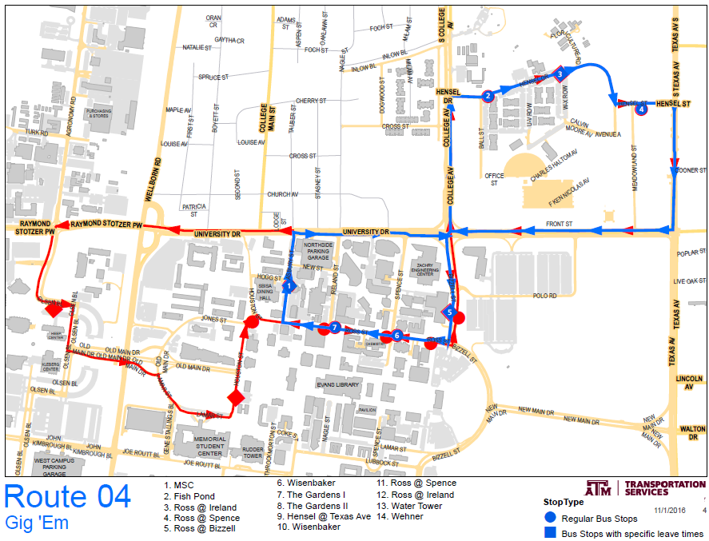
Route 04 Modifications

Slide 11
Route 04 Modifications
Shorten route to serve east campus only
Transfer to Route 01 for travel to west campus
Reduce 3 buses to 2 due to shortened route
Reallocate bus to Route 01 for capacity purposes
By modifying route, frequency will improve to 10 minutes between buses
Route 04 will not service Wehner
89% of total ridership on route use stops other than Wehner
Routes 01, 03, 06 and 09 service Wehner and MSC

Slide 12
Usage of Wehner Stops
Removing Route 04 will not impact travel to MSC - capacity is available on Route 09
Route 04 currently only carries 4% of passengers from Wehner.
Notes:
At the Wehner Stop, the order of routes from front to back is 09, 03, 04 and 06.
The numbers indicate the passengers tend to use the buses in reverse order as they are the closest to Wehner.

Slide 13
Current Route 06 and Route 08
Route 06
3 buses
Service to the MSC, Wehner and GSC
7 minutes between buses
Route 08
2 buses
Service to the MSC, PEAP, Reed Arena and Blue Bell Park
10 minutes between buses

Slide 14
Proposed Route 06 GSC and Route 06 Blue Bell
Routes provides connection between north and south sides of campus without need to transfer
Name changes to clarify direction
Routes and stops remain the same
Routes will use 5 buses
9 minute service between buses
Heavy marketing and communication effort to educate passengers on change
Notes:
What should the name be? Keep 08 and 06 to keep passengers straight. Same bus stop used for 06/08. Use 06 GSC and Blue Bell or use 06/08?
Combined 10 years ago. Since then, GSC built, more parking at Reed Arena, etc.

Slide 15
Proposed Route 06-GSC and Route 06-Blue Bell

Slide 16
Off-Campus Modifications
Route 12 – Move main campus stop from MSC to the Trigon saving 5 minutes
Reallocating buses from off campus to on campus to better serve needs mid-day
Match quantity of buses to ridership levels from 6pm to 8pm
Night Route 34 and 36 – Combine routes at night to better match ridership levels

Slide 17
Route 12
Move main campus stop from MSC to the Trigon
Reduce run time by avoiding University Drive and Texas Avenue
Avoid unprotected left turn from Texas Avenue to Lincoln
Fish Pond stop is eliminated - access north side of campus via Route 01
Route 12 Trigon stop located directly behind Route 01 for ease of transfer

Slide 18
Accommodating Ridership for Park West
Complex located between Penberthy, Luther and George Bush
3700 beds for fall 2017
Routes 35 and 36 currently travel by complex
Relocate one stop on Route 35 for closer bus stop access for residents
Route 36 will remain the same
Add 1 bus to both routes for peak morning and afternoon service

Slide 19
Proposed Route 35 and Current Route 36

Slide 20
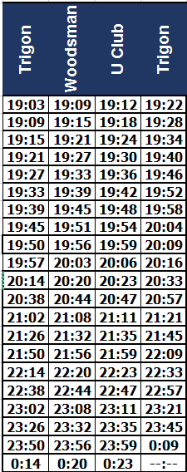
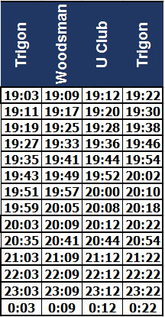
Night Routes 34 and 36
Combine routes at night to better match ridership levels
Currently run this combination on weekends
Route 36 data shows average ridership is 30-35 per trip until 8:30 pm
Extend day buses to match current service until 8:30 pm to ease this transition
Current 36 after 7p
Proposed 36 after 7p

Slide 21
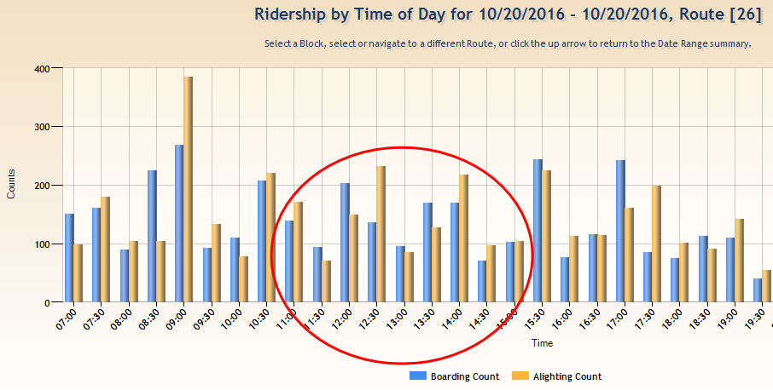
Reallocating Resources
Currently reviewing data for all off campus routes to determine which routes can accommodate the reduction mid day and where to reallocate on campus. Example:
Route 26 – 5 to 4 buses from 11a-3p

Slide 22
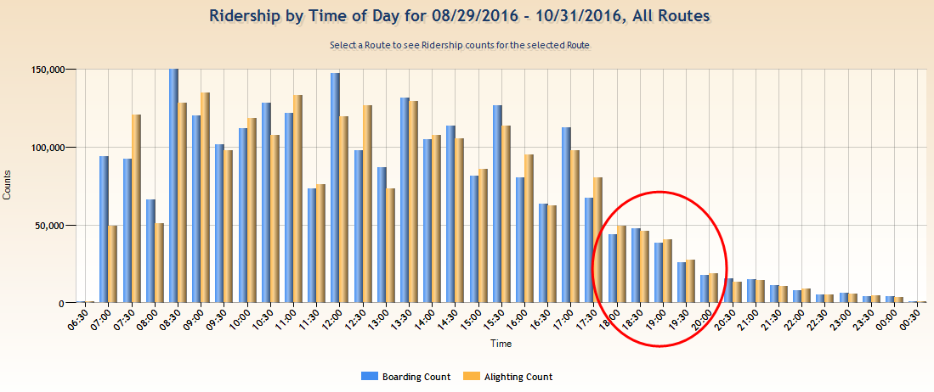
Matching Buses to Ridership
Match quantity of buses to ridership levels from 6pm to 8pm Mon – Fri

Slide 23
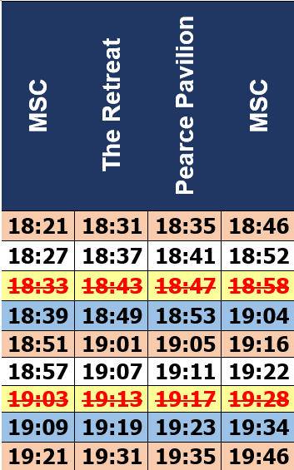
Matching Buses to Ridership(cont.)

Slide 24
Questions?

