Slide 1
Northside Parking Garage Study
TSAC
April 3, 2013

Slide 2
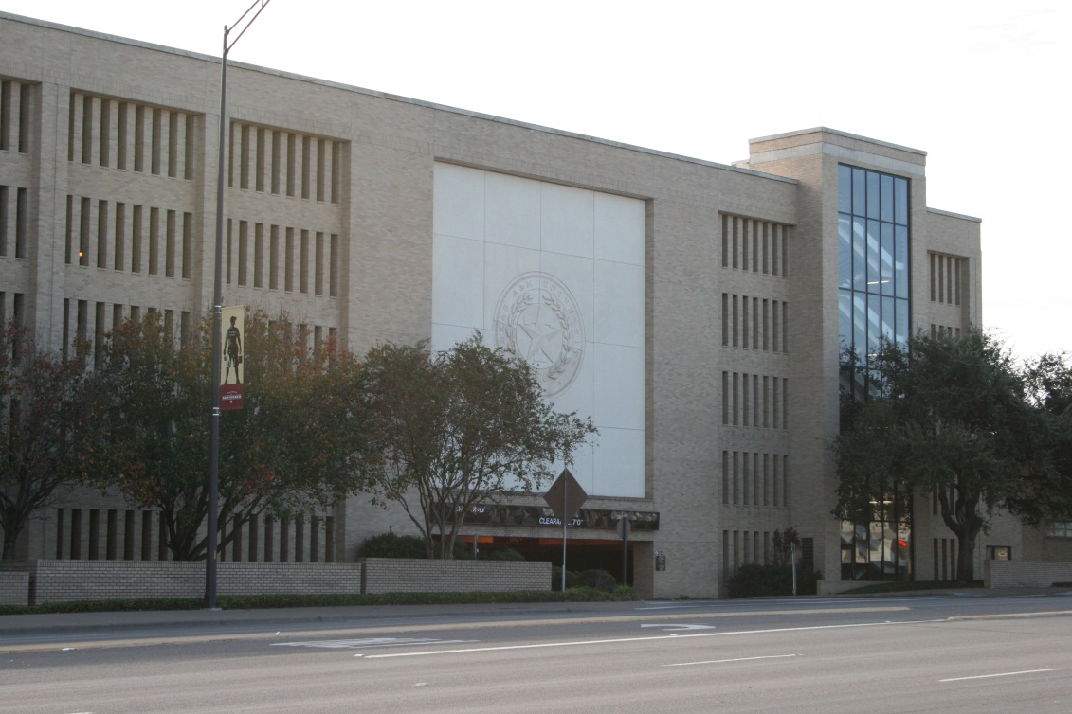
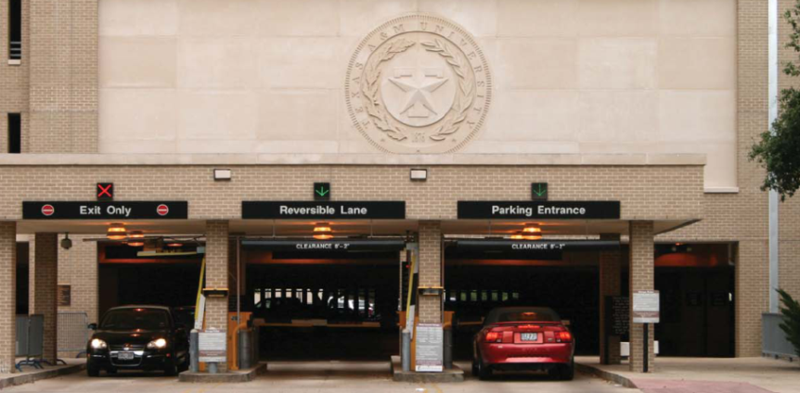
Study Elements
Need for Increased Visitor Parking in the Northside Garage
Using Equipment to improve circulation and efficiency

Slide 3
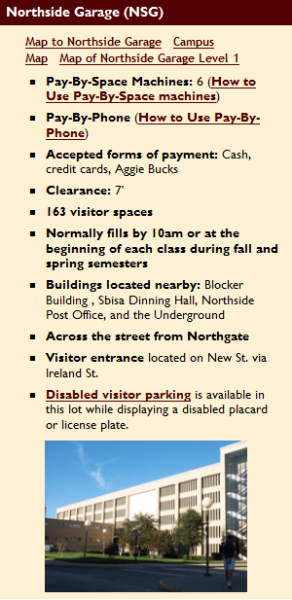
Existing Conditions
Visitor = 163 Spaces
Reserved= 469 Spaces
Regular = 1,175 Spaces
ADA = 29 Spaces
Other = 1 Space
= 1,837 Spaces

Slide 4
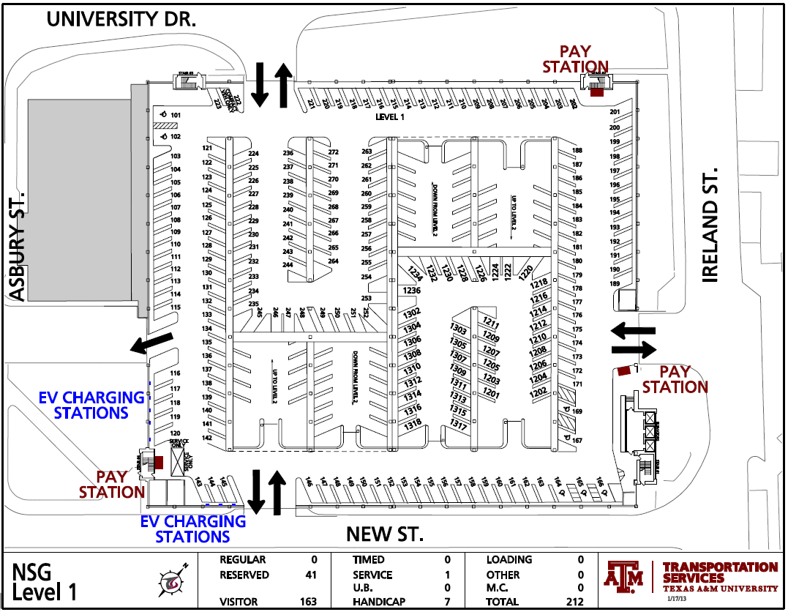
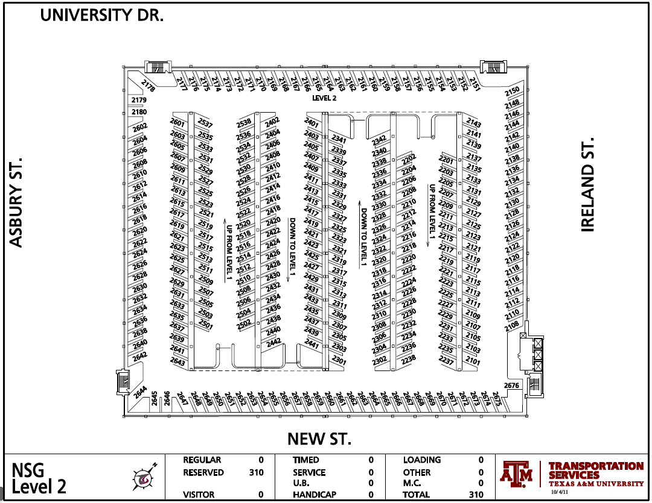
Existing Conditions

Slide 5
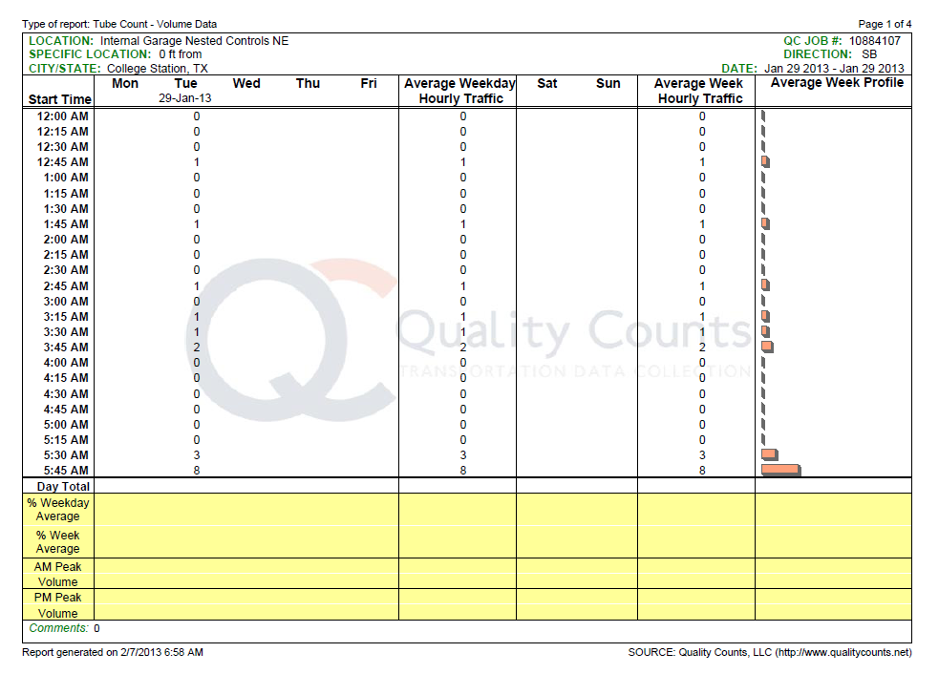
Visitor Supply / Demand Study
Real Time Data Counts
Traffic Counts
Field Observed Visitor Demand

Slide 6
Supply / Demand Study Results
Visitor Peak Hour Tuesday / Thursday is 1:00 p.m. to 2:00 p.m.
Latent Visitor Demand = 63 Visitor Parkers in the Peak Hour
Recommended Visitor Parking =
(163 + 63 + 10%)
= 250 Spaces +

Slide 7
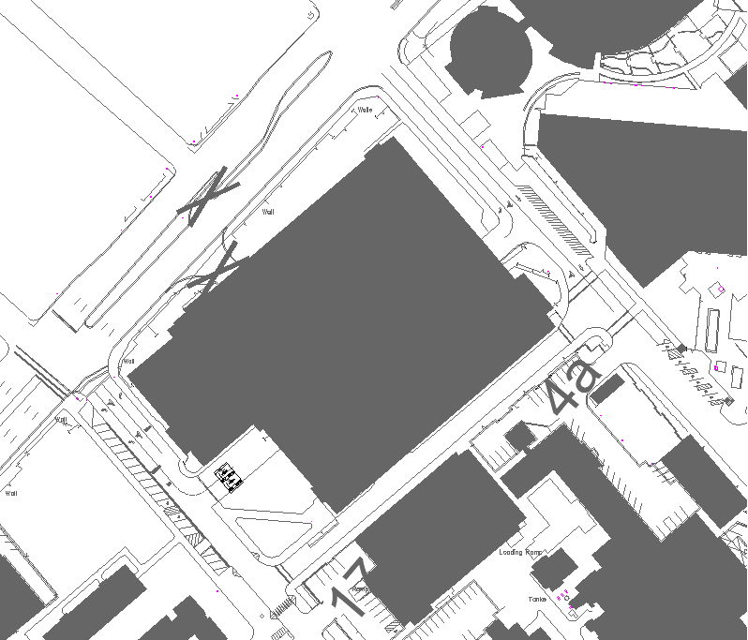
Traffic / Access Analysis
Close University Drive Entry / Exit
Place Entry / Exit Gates at Ireland and New Streets
Place Exit Gates to Asbury Street
Accommodate Pay on Foot and/or Pay in Lane

Slide 8
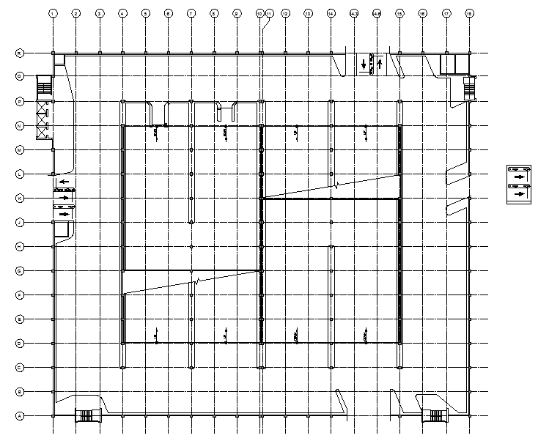
Traffic / Access Analysis

Slide 9
Implementation Options
New External Gates - No Internal Gates
*(Similar to Central Campus Garage)
PROS CONS
- Precision - Increased Risk of Reserved - Flexibility Space Violation
- Less Equipment - Increase Reserved Space
- ADA Flexibility Signage and/or equipment
- Decreased service for both
* Priority Bay Would Remain permit holder and visitor
Notes:
**
All of these cons are because of RNS.

Slide 10
Implementation Options
2. New External Gates – Move Internal Gates to 3rd Floor *(Similar to University Center Garage)
PROS CONS
- Control of Reserved Spaces - Too Many Visitor Spaces
- Increased service for both - Less Flexibility
permit holder and visitor - More Equipment
by reduced violations - Fewer student permits

Slide 11
Implementation Options
New External Gates - Add 2nd Gated Priority Bay and Remove Upper Level Gates
PROS CONS
- Precision - Increased Risk of Reserved - Flexibility Space Violation
- Less Equipment
- ADA Flexibility
- Adds 41 Reserved Spaces
to 1st Floor
Notes:
New Priority Bay Spaces help accommodate RNS customers who don’t like the new ungated arrangement

Slide 12
Implementation Options
4. New External Gates - Close University Drive Entry/Exit
PROS CONS
- Improved Traffic Flow - Initial Customer Perception

Slide 13
Implementation Options
5. No New Gates - Close University Drive Entry/Exit
PROS CONS
- Improved Traffic Flow - Initial Customer Perception

Slide 14
Next Steps
Select Preferred Control Option
Prepare Plans and Specifications for Implementation

